Slide 1


Enrollment management
2018-2020

Slide 2
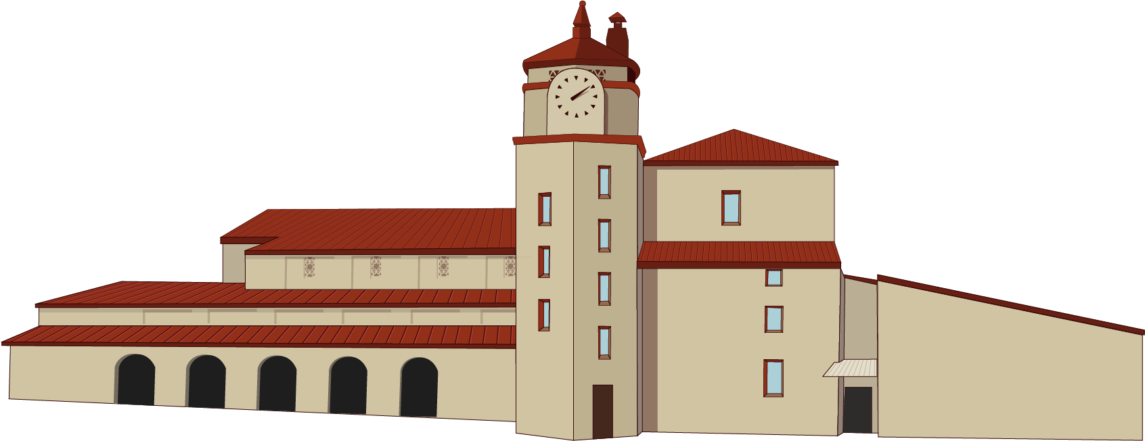

enrollment management
planning

Slide 3
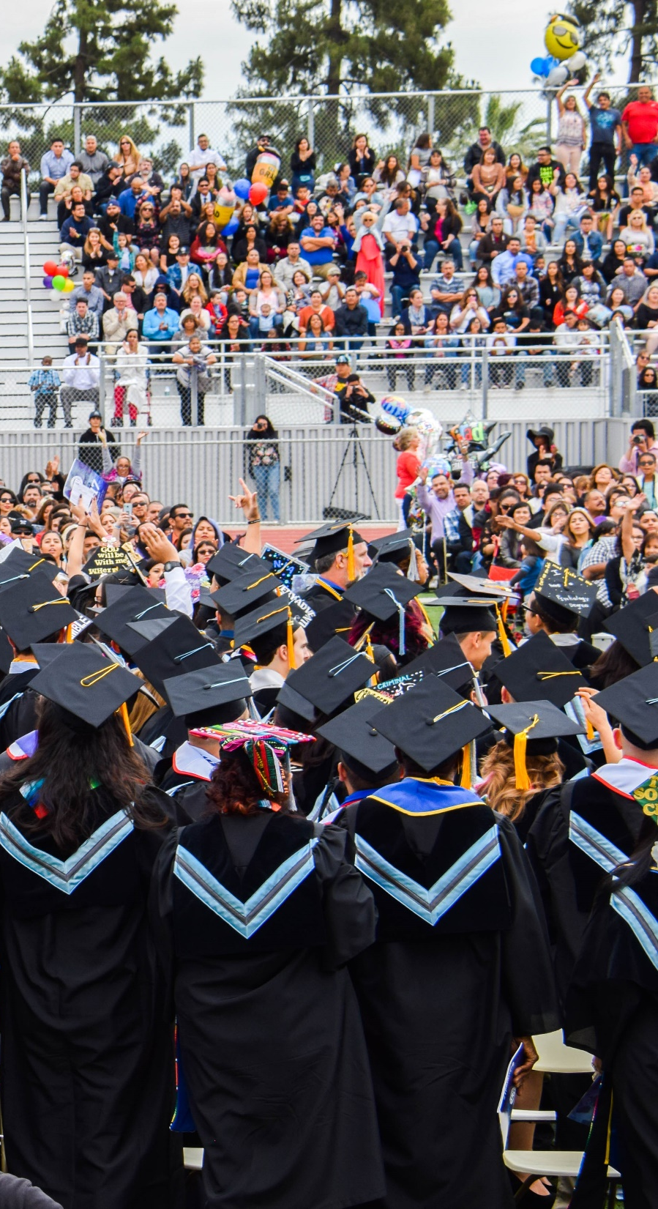


Purpose
The purpose of the Enrollment Management Plan is to create a responsive, flexible, educationally sound, research-based approach to enrollment management.
This Enrollment Management Plan is intended to provide strategic direction to the college, our educational programs, our students, our employees, and our educational partnerships during periods of enrollment growth and decline.
The Enrollment Management Plan is intended to ensure the following:

Slide 4

Purpose
Maintain student access and provide clear pathways for students to achieve their educational goals;
Achieve enrollment targets in order to maximize resources and funding;
Protect programs to allow for student completion during times of declining enrollment;
Develop a class schedule responsive to the needs of our students.
Maintain comprehensive educational programs that are responsive to the needs of our students and the community;
Provide clear integration and alignment with the new funding formula for California Community Colleges;
Align with State Chancellor’s Office Vision for Success Goals.

Slide 5
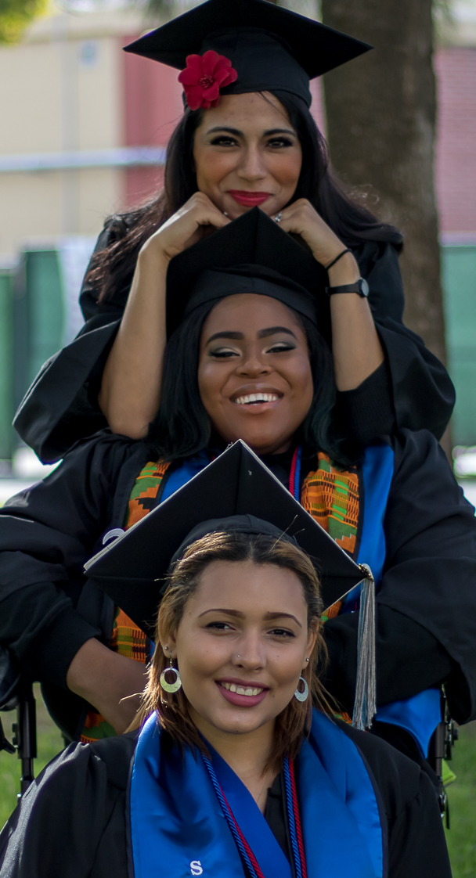
Enrollment Management: Top 10 Areas of Focus
Online Degree/Certificate Offerings
Open Education Resources and Zero Textbook Cost Courses and Degrees
Evening/Weekend College Programs and Off-Site Locations
Noncredit Programs Offerings and Adult Education
Dual/Concurrent Enrollment/AB288 opportunities for high school students
Programs to serve AB540 Student Populations
Programs to improve efficiency, success, and retention
Guided Placement
Cohort programs such as Valley Bound, FYE, EOP&S, Promise, CalWORKS etc.
Labor market data to create new programs and modify existing programs to respond to local job opportunities

Slide 6
the vice president’s perspective

Slide 7
As a VPSS, how do you perceive the role your college marketing department plays in enrollment management?

Slide 8

How can Student Services collaborate with college marketing/public relations departments to impact enrollment?

Slide 9
How would you encourage collaboration between Student Services and Marketing/Public Relations at your college?

Slide 10
Relationship between marketing & enrollment

Slide 11
Objectives & Initiatives
The Department of Marketing & Public Relations has been assigned the following objectives for the 2018-19 academic year:
Attract prospective students to increase the number of new student applications;
Increase SBVC’s brand visibility and differentiate it from its competitors;
Increase visibility of SBVC student, staff and alumni successes and accomplishments;
Improve SBVC’s reputation and public understanding of its programs and course offerings;
Increase digital engagement and conversions on the SBVC website;
Assist with retention of existing students.

Slide 12
Relationship Between Marketing & Enrollment
The SBVC Department of Marketing & Public Relations impacts enrollment and retention by generating leads to the SBVC website through 4 targeted marketing strategies (Strategies 1-4), as well as through 4 comprehensive advertising and promotional campaigns throughout the year (Campaigns 1-4). These strategies and campaigns generate leads to the SBVC website, assist students with the application and registration process, and encourage them to stay at SBVC until they complete their degree or certificate.

Slide 13
The SBVC Student Conversion Funnel:
Recruitment & Matriculation

Slide 14
The SBVC Student Conversion Funnel:
Completion & Retention

Slide 15
Targeted marketing strategies

Slide 16
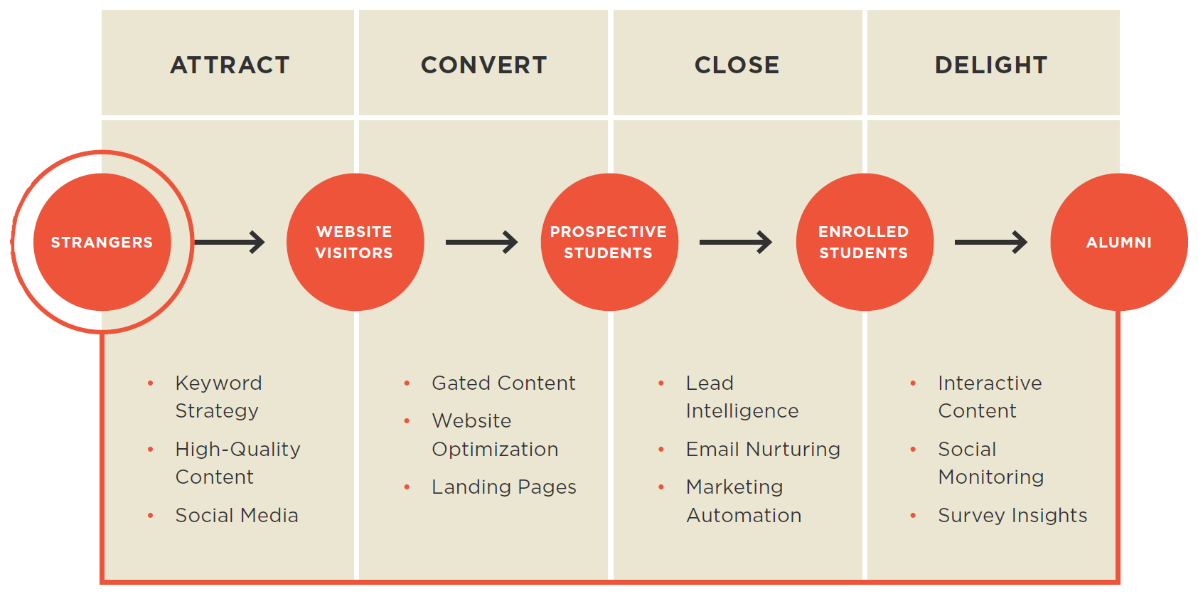
Strategy 1: Content Marketing for Enrollment Growth
The Department of Marketing & Public Relations develops a large quantity of original written content, artwork, photography, video, and other media for use in communicating with target audiences, building engagement, and promoting SBVC in the community. Every semester, the department strives to improve on its media production capabilities and produce the most engaging media possible to continue to drive engagement and receive the greatest possible return-on-investment in its promotional efforts.

Slide 17
Strategy 1: Content Marketing for Enrollment Growth
Strategy Goals, 2018-2019:
Photography
Provide media coverage for over 170 community-oriented campus events and distribute photos to staff, students, and community members;
Develop 200+ campus promotional photos for use in publications, presentations, social media, and other communications platforms;
Videography
Develop a new, 30-second video commercial to showcase SBVC’s academic programs;
Develop 2 mini-commercials or promotional videos to highlight individual SBVC programs.
Editorial Content
Develop 60+ media releases for distribution to the press and community influencers;
Develop 50+ new student, staff, faculty, alumni, and/or program spotlight articles;
Develop stories about all major achievements, events, and other SBVC “bragging rights.”
Graphic Design
Develop 300+ original website and social media graphics for promotion of campus events, programs and initiatives;
Develop 100+ new designs for printed flyers, brochures, posters, signage, publications, promotional items, and original artwork.

Slide 18
Strategy 2: Integrated Campus Communications for Enrollment Growth & Retention
As part of its campus communications management responsibilities, the department creates original video content and manages the Campus TV system, which is comprised of 12 large screen television displays in various buildings across campus. The department also develops and manages video content for the two outdoor marquees on campus, the scrolling marquee at the entrance to the stadium, and the jumbotron inside the stadium, as well as the desktop wallpapers on student computers in computer labs across campus.
As part of its print display management responsibilities, the department manages the development, printing, and installation of posters inside the 9 display stands across campus, hundreds of pole banners along campus walkways and in parking lots, lawn signage, and various other printed banners that are installed on campus to communicate institutional messaging throughout the year.

Slide 19
Strategy 2: Integrated Campus Communications for Enrollment Growth & Retention
Strategy Goals, 2018-2019:
Digital Display Systems
Develop 300-600 original animations to promote campus events and programs to students, staff, and visitors on campus on SBVC’s digital signage system (9 TV monitors and 3 outdoor marquees);
Develop customized promotional desktop wallpapers for thousands of PCs and laptops on campus.
Printed Display Systems
Develop 4 street-facing sign wraps to promote SBVC programs and application to local community members and passers-by;
Develop 80-100 vinyl flagpole banners to promote campus programs to students, staff, and visitors, and improve the campus’s aesthetic appeal;
Develop 100+ lawn signs to promote campus programs to students, staff and visitors;
Develop 150+ campus posters to promote campus programs to students, staff and visitors.

Slide 20
Strategy 3: Social Media Audience Expansion & Engagement
In its management of the college’s social media presence, the department coordinates the content and communications on 83 Facebook, Instagram, Twitter, LinkedIn, Snapchat, Google+, and YouTube channels that represent the college, one of its departments, or other affiliated organizations. The number of followers for all SBVC social media channels combined totaled 106,205 in March 2018, with an estimated reach of 300,000-400,000 impressions per month. The long-term goal is to continue to increase the size of SBVC’s social media subscriber base and their levels of engagement with the college.

Slide 21
Strategy 3: Social Media Audience Expansion & Engagement
Strategy Goals, 2018-2019:
Facebook: 35 accounts; 80,160 followers
Develop 200+ engaging and creative posts to drive user engagement, increase social media following on Facebook, promote SBVC programs, application, retention and student success, and drive traffic to the SBVC website.
LinkedIn: 1 account; 12,684 followers
Develop 25+ engaging and creative posts to drive user engagement, increase social media following on LinkedIn, promote SBVC programs, application, retention and student success, and drive traffic to the SBVC website.
Instagram: 21 accounts; 6,629 followers
Develop 100+ engaging and creative posts and stories to drive user engagement, increase social media following on Instagram, promote SBVC programs, application, retention and student success, and drive traffic to the SBVC website.
Twitter: 20 accounts; 5,832 followers
Develop 200+ engaging and creative posts to drive user engagement, increase social media following on Twitter, promote SBVC programs, application, retention and student success, and drive traffic to the SBVC website.

Slide 22
Strategy 3: Social Media Audience Expansion & Engagement
Strategy Goals, 2018-2019:
Snapchat: 1 account; 574 followers
Develop 200+ engaging and creative stories to drive user engagement, increase social media following on Snapchat, promote SBVC programs, application, retention and student success, and drive traffic to the SBVC website.
Google Plus: 3 accounts; 262 followers
Develop 25+ engaging and creative posts to drive user engagement, increase social media following on Google Plus, promote SBVC programs, application, retention and student success, and drive traffic to the SBVC website.
YouTube: 2 accounts; 64 followers
Develop 5-10 engaging videos to drive user engagement, increase subscriber base on YouTube, promote SBVC programs, application, retention and student success, and drive traffic to the SBVC website.

Slide 23
Strategy 4: Website Optimization for Enrollment Growth & Retention
The department is the primary manager and editor of content on the college’s website and mobile app. The college receives approximately 3,000,000 views by 700,000-800,000 visitors per year, out of which approximately 95% are first-time visits. The college website is updated multiple times on a daily basis to accommodate the communications and promotional needs of the campus, resulting in over 4,000 edits per academic year. However, because of the website’s excessive complexity and lack of mobile optimization, it requires a significant amount of maintenance and content optimization to make its interface more responsive, intuitive, and user-friendly (and less frustrating), thus improving the college’s ability to attract new student applicants and retain existing students.

Slide 24
Strategy 4: Website Optimization for Enrollment Growth & Retention
Strategy Goals, 2018-2019:
Post 240+ website graphics and banners to improve user navigation and inform users about college programs, events, and facilitate the applications and registration process;
Post all press release and news content on the website to improve search engine optimization and promote SBVC to all internal and external users;
Make all necessary edits to improve website legibility and usability, reducing quantities of unnecessary text, reducing click paths, and streamlining calls-to-action;
Develop and integrate a “custom viewbook” into the website that streamlines the student prospecting process, improves the website’s usability and user engagement;
Develop a functional, mobile-optimized landing page in preparation for a complete website redesign in the near future.

Slide 25
2018-19 MARKETING PLAN RESULTS
JULY 2018 - MARCH 2019
PAID MEDIA
7,384,423+ AD IMPRESSIONS
398,880+ VIDEO VIEWS
121,869+ ENGAGEMENTS
66,124+ CLICKS TO WEBSITE
WEBSITE ACTIVITY
2,248,943 WEBSITE VISITS BY 659,833 VISITORS
58,006 VISITORS TO CLASS SCHEDULES
48,378 VISITORS TO OPEN CLASS LISTS
47,639 VISITORS TO NEW STUDENT APPLICATION

Slide 26
the marketing director’s perspective

Slide 27
Closing
remarks

Slide 28
Questions & answers

